Slide 1
Exp 02
Write a program for implementation of simple linear regression

Slide 2
simple linear regression
Linear regression is a statistical approach for modeling relationship between a dependent variable with a given set of independent variables.

Slide 3
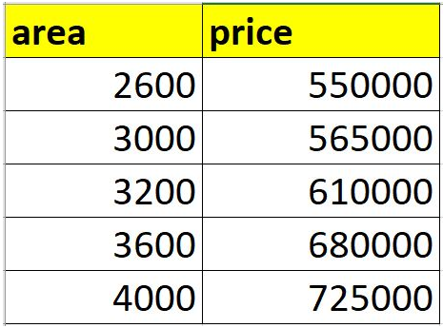
Sample problem of predicting home price
Below table represents current home prices based on square feet area.

Slide 4
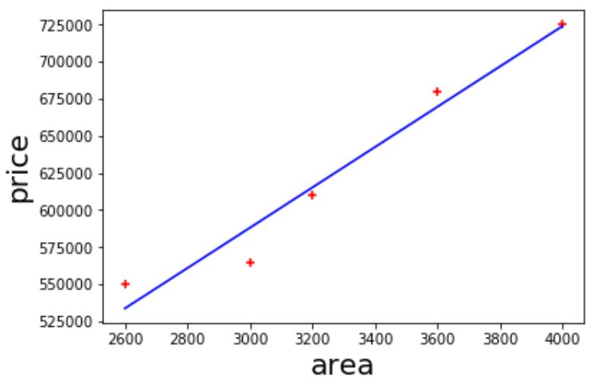
Problem Statement: Given above data build a machine learning model that can predict home prices based on square feet area
You can represent values in above table as a scatter plot (values are shown in red markers). After that one can draw a straight line that best fits values on chart.

Slide 5
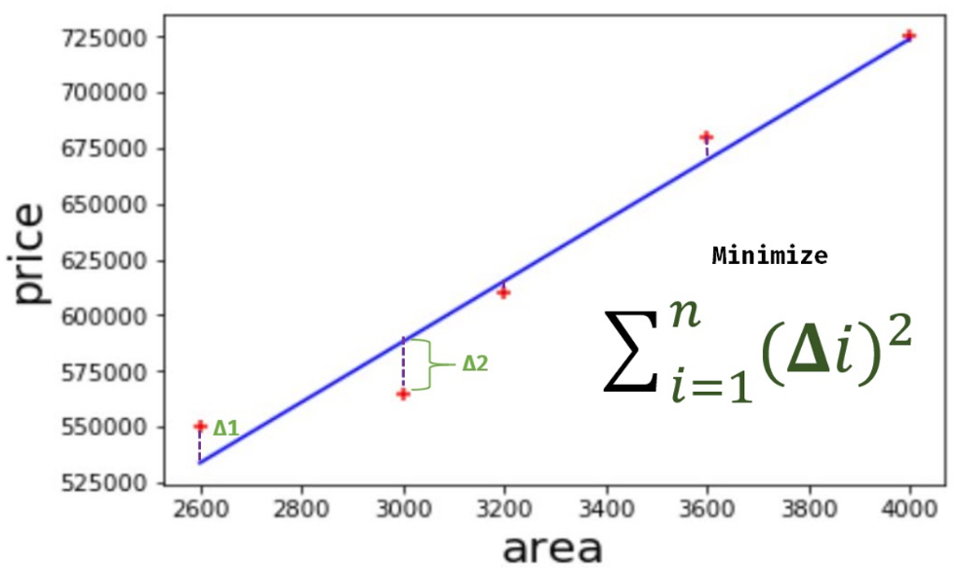
You can draw multiple lines like this but we choose the one where total sum of error is minimum

Slide 6
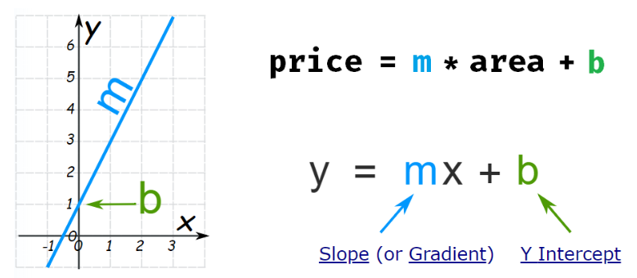
You might remember about linear equation from your high school days math class. Home prices can be presented as following equation
home price = m * (area) + b
Generic form of same equation is,

